Slide 1

SPAM Mail classification Python project
Arthur Wiriath
Benjamin Sliosberg

Slide 2
Scope of the problem
We have access to a dataset representing 4602 emails, each of them have been resumed in 58 features.
The first 57 features are the frequency of apparition of certain words or characters in the mail, the 58th being the classification of this mail as spam or not.
We are tasked to find an appropriate machine learning model to classify and predict if a new given email is a spam or not.

Slide 3
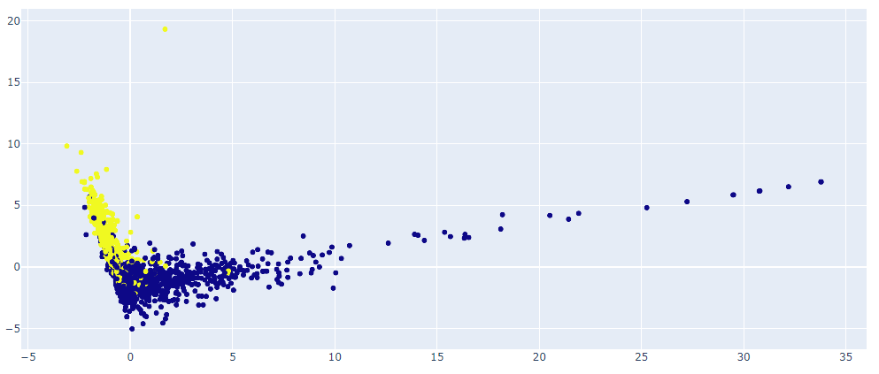
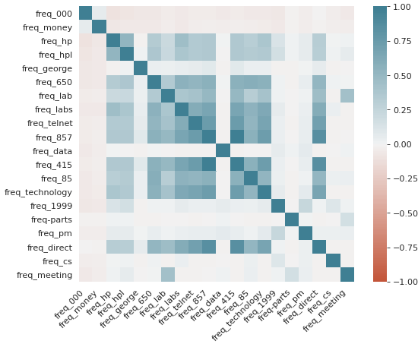
Visualisation
First step for understanding the data is visualisation, we used two methods to start. PCA and the correlation matrix of the features.

Slide 4
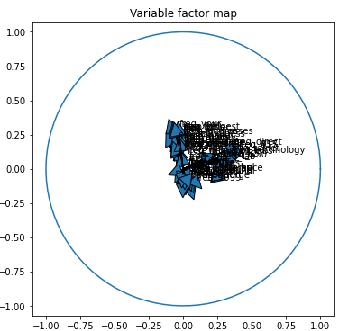
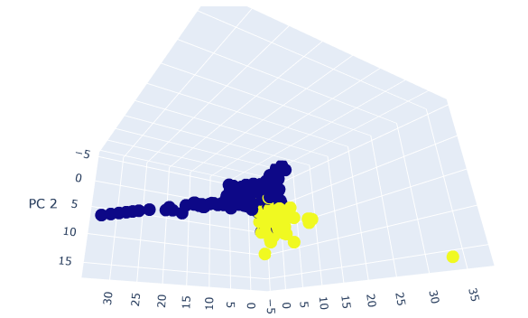
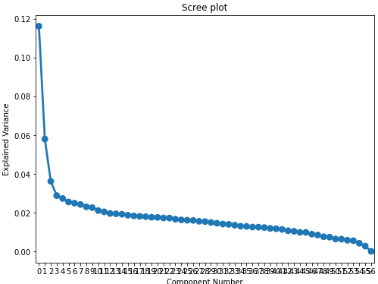
Principal components Analysis visualisation
We visually observe that with a 2D and 3D PCA, the spam/not spam datapoints are very distinguishable from one another.
Apart from the 3 first visual components, all the other features seem to have the same weight in the classification of a mail.

Slide 5
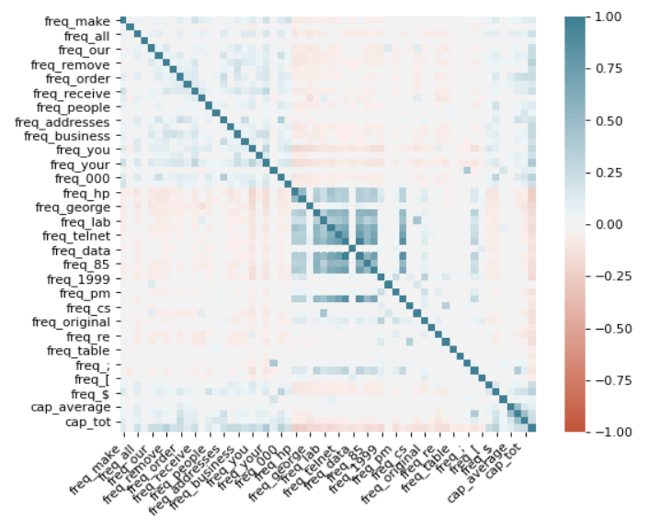
Correlation Matrix visualisation
The analysis of the data using correlation matrix shows us that the data columns have probably already been sorted to show strong areas of correlation.
We observe that the frequency of apparition of the word “George” (name of author of the dataset) and frequency of the word “data” doesn’t influence other features as we’d expect.

Slide 6
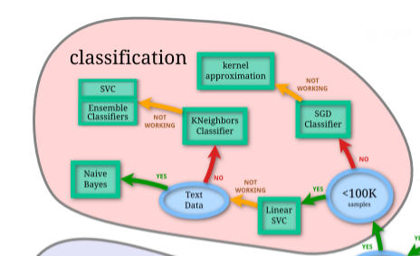
Data classification and Prediction using sklearn
Using the sklearn cheatsheet, we know theoreticaly what model to use.
We decided to implement in order :
a KNN, SVC, Random Forest Classifier and a Neural Network model. To compare precision results of each method.

Slide 7
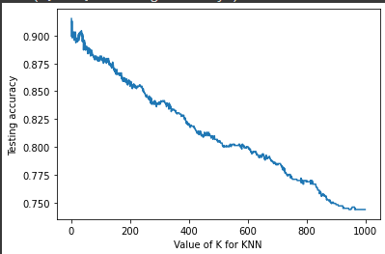
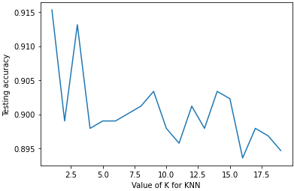
K-Nearest neighbors
We tested the Knn algorithm on our model with different hyperparameters values to find the best k.
We observed a clear trend in the efficiency of the model depending on the k used.
Our strongest results are with k = 1 and k = 3 with an accuracy of 91%

Slide 8


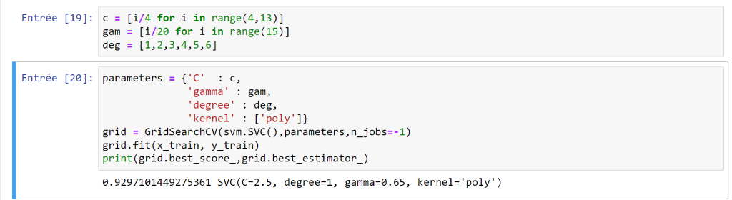
support vector machines - Classification
We decided to use an SVC with and without changing hyperparameters and the optained results were suprising.
With a basic SVC we optained 94.84% of accuracy on the training
Using a grid search using multiple hyperparameters our best model gave us a 94.68% accuracy rate. Which is an unexpected result. Default parameters are better than heristics in this case.

Slide 9
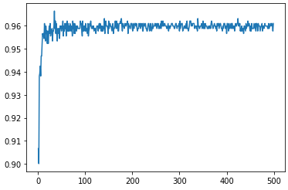
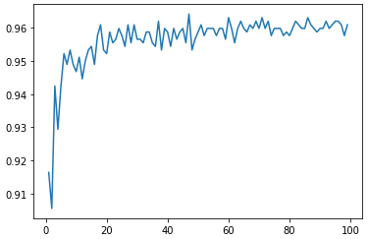

Random Forest Classifier
Our third choice was to use a random forest classifier, we varied the n_estimators hyperparameter and obtained this graph of accuracy.
We observe a plateau of 96% after 20 estimators
Excelente accuracy for this method.

Slide 10
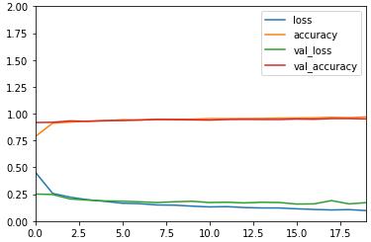
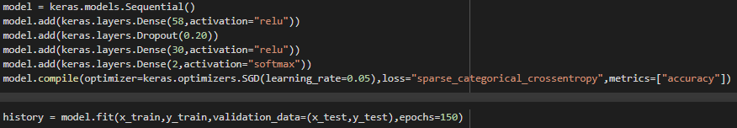
Artificial Neural Network
After using sklearn, and observing various models with pretty good accuracy, we tried implementing an ANN with the keras library.
We tried implementing with various parameters : different number of layers, number of nodes, activation functions, loss functions and metrics.
The final model optained is one of the strongest models with an accuracy of 95.44%

Slide 11
Experimental Method
Once all these models were fitted to our dataset, we tried mixing two models to try to have better results.
We tried mixing the ANN with the other models, by looking at the ANN output. For each decision of the ANN we evaluate if the decision is clearly the good one.
Since the 2 output nodes have a softmax activation function there value fluctuates between [0;1], we evaluate that answer and if the decisive node is less than 95% of the answer we apply the model on this point.
This method has shown an increase in accuracy compared to ANN or other models alone.

Slide 12
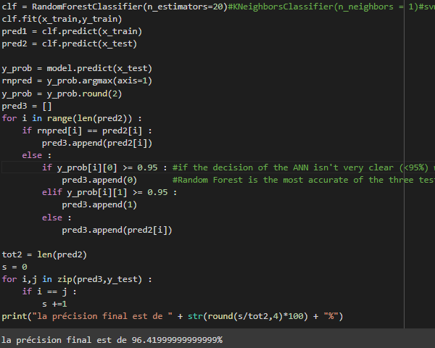
Experimental Method
The threshold of 95% of decisiveness has been chosen to use with RandomForest. We obtain the absolute best result of accuracy with this method : 96.42%

Slide 13
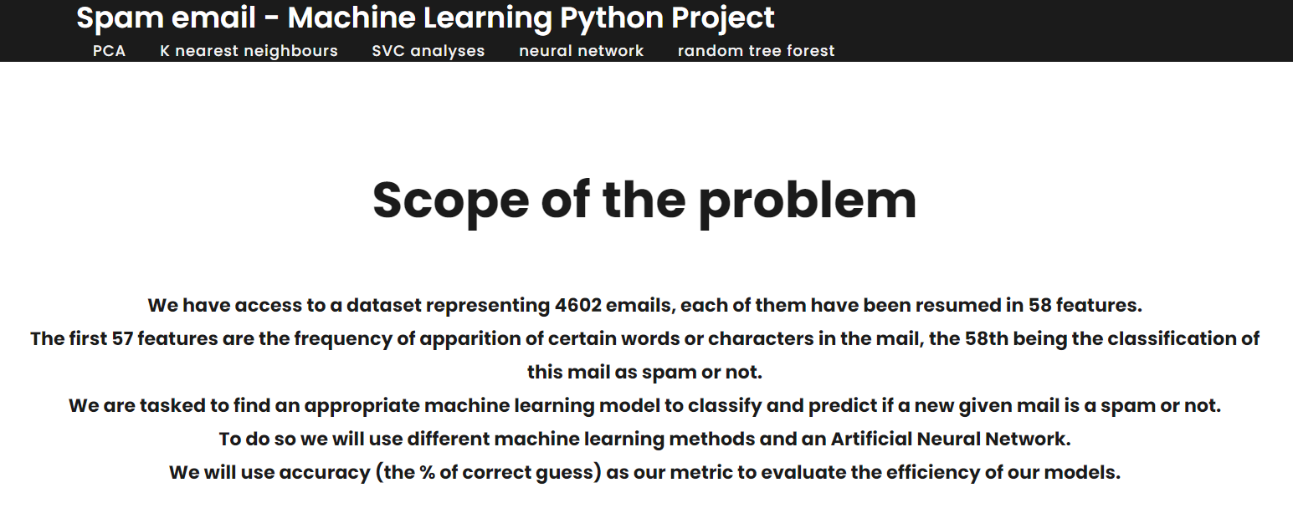
Django Interface
We designed a small Django Interface wich allows a user to view our results and our thought process.
The user can navigate between pages by clicking on the desired method to explore.

Slide 14
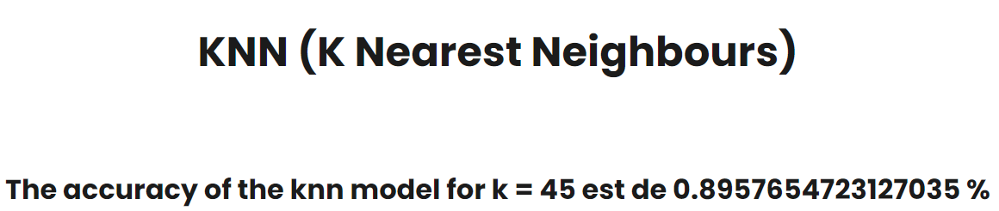
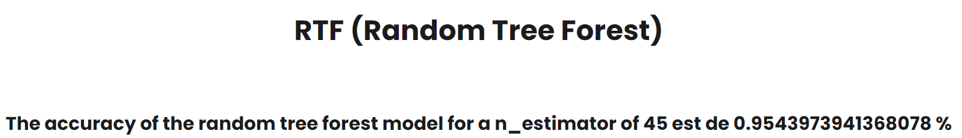
Django Interface
The user can input a desired parameter for the KNN and RandomForest algorithms by entering it in the url task bar when browsing through these two pages.
The accuracy result is then showed to the user.
Url example : http://127.0.0.1:8000/knn/45/ (will show the accuracy of the knn algortithm with a neighbour parameter of 45)

